Slide 1




Introduction to React.js
What is React
JSX Overview and Syntax
React.js
Intro
SoftUni Team
Technical Trainers
Software University
http://softuni.bg

Slide 2

Table of Contents
React Overview
Installation
JSX Syntax
Rendering
Hello World

Slide 3
Have a Question?
sli.do #js-web

Slide 4

React Overview
History and Philosophy

Slide 5
What is React.js?
React is a JavaScript library for building user interfaces (UI)
Focused on creating reusable components
Developed by Facebook engineer Jordan Walke
class HelloMessage extends React.Component {
render() {
return <div>Hello {this.props.name}</div>;
}
}
ReactDOM.render(<HelloMessage name="Maria" />,
document.getElementById('main'));

Slide 6

Features
Open-source
Declarative
Design simple views for each state in your app
Easier to debug
Component-Based
Encapsulated components that manage their own state
Keep state out of the DOM

Slide 7

Features
Isomorphic
JavaScript that runs on both client & server
Better user experience
Native support
Compose rich mobile UI in Android, iOS

Slide 8









React Users

Slide 9

Advantages
Easy to learn
Fast performance
Use all of ES6 features
Promises, Classes and Modules
Compatible with other libraries
Great error reporting

Slide 10



React Installation
Packages, Setup, Structure

Slide 11
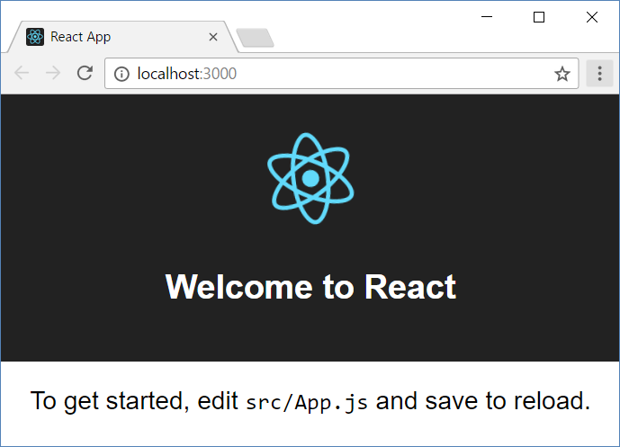
Install and Run the React App Creator
Install the React app creator (one-time global install):
Run the React app creator
Starts your React app from the command line
Browse you app from http://localhost:3000
npm -g install create-react-app
create-react-app react-example
npm start

Slide 12
Finding Information
Visit the official website
Documentation
Online sandbox
https://reactjs.org/
https://reactjs.org/docs/installation.html
www.codepen.io/gaearon/pen/rrpgNB?editors=0010

Slide 13
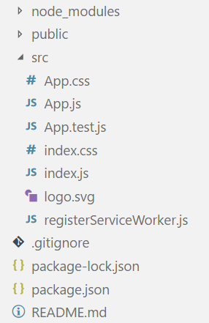
React App Structure
package.json – project configuration
Module name, dependencies, build actions
index.html
App main HTML file
index.js
App main JS file (startup script)
App.js, App.css, App.test.js
React component "App"

Slide 14


JSX Syntax
JSX
Overview, Syntax, Advantages

Slide 15

JSX Overview
JSX is React's JavaScript superset language
Has all of JavaScript's features and more
Unique approach to mixing HTML and JS
Compiles to plain JavaScript
<div className="red">Children Text</div>
JSX
React.createElement("div",
{ className: "red" },
"Children Text" [, …]);
component

Slide 16
JSX Syntax
<div className="red">Children Text</div>
Expression
<MyCounter count={3 + 5} />
var gameScores = {
player1: 2,
player2: 5
};
<DashboardUnit data-index="2">
<h1>Scores</h1>
<Scoreboard className="results" scores={gameScores} />
</DashboardUnit>;
Custom component
Assign variable as property

Slide 17
Advantages
Write HTML directly in your script
No templating engines required
Support for ES6 modules
Support for asynchronous functions
Errors visible during compilation
let dropdown = <Dropdown>A dropdown list</Dropdown>

Slide 18
JSX Rules and Principles
Standard elements use lowercase names
div, span, form, input, …
Custom components always use title case
MyCustomComponent, Greeting, ScoreBoard, …
Element type cannot be an expression – use a variable instead
There must be a root element
More info at: https://reactjs.org/docs/jsx-in-depth.html

Slide 19
Compilation
JSX compiles to function calls
<div className="red">Children Text</div>
Element type (HTML tag name)
Properties object
React.createElement("div",
{ className: "red" },
"Children Text" [, …]);
List of children

Slide 20



Supported Browsers
React supports all popular browsers
Including Internet Explorer 9!
Compiled JSX will work on any browser that has ES5
Some features may need to be polyfilled
https://github.com/es-shims/es5-shim

Slide 21


Rendering Engine
Rendering Elements, Virtual DOM

Slide 22
Rendering Elements
React elements are plain object
Unlike DOM elements, they are cheap to create
To output an element on the page:
JSX elemet definition
const element = <h1>Hello, world</h1>;
ReactDOM.render(
element,
document.getElementById('root')
);
Target container

Slide 23
Virtual DOM
React keeps track of all elements in a virtual DOM
On change, a diffing algorithm is applied
Only the needed parts are updated in the browser
More info at: reactjs.org/docs/reconciliation.html
React syntax is declarative
You only describe the desired result
ReactDOM takes care of the order of operations

Slide 24


Hello World with React.js
Live Demo

Slide 25
Summary
React is a JavaScript library for building user interfaces.
React uses all of the ES6 features.
JSX is React's JavaScript superset language
Rendering an element is done in the following way:
<MyCounter count={3 + 5} />
ReactDOM.render(
<h1>Welcome to React.js!</h1>,
document.getElementById('root')
);

Slide 26












Introduction to React.js
https://softuni.bg/courses/

Slide 27

License
This course (slides, examples, demos, videos, homework, etc.) is licensed under the "Creative Commons Attribution-NonCommercial-ShareAlike 4.0 International" license

Slide 28





Trainings @ Software University (SoftUni)
Software University – High-Quality Education, Profession and Job for Software Developers
softuni.bg
Software University Foundation
http://softuni.foundation/
Software University @ Facebook
facebook.com/SoftwareUniversity
Software University Forums
forum.softuni.bg

